Slide 1

Medical Image Anaysis
Automated Capillary Detection
Atanda Abdullahi Adewale, Qian Zhilling
VIBOT Univ. Bourgogne - MSc in Computer Vision, 2023

Slide 2
Abstract
Nailfold capillaroscopy is a non-invasive imaging technique employed to assess the microcirculation of blood capillaries.
Knowing the numbers of capillaries present in a region of interest is valuable for medical diagnosis, research purposes, image analysis, treatment evaluation, monitoring disease progression and treatment response.
In this work, we propose a method to detect numbers of present capillaries in a low quality ROI of Nailfold capillaroscopic images.
Image processing techniques such as pre-processing, binarization, Adaptive thresholding segmentation and morphological operation are designed to obtain the number of capilllaries.
After implementation, all parameters can be measured automatically and the detection has accuracy up to 80% based on groundtruth image.
Dataset images are four categories images of clean and diseased images with different luminousity variariations, additionally implementation was done in python Jupyter Notebook with OpenCV and Skimage.

Slide 3
Introduction
Capillaroscopy is a non-invasive imaging technique used to visualize capillaries in the human microcirculation, aiding in the diagnosis of various medical conditions. However, the quality of capillaroscopic images can be compromised by low resolution, noise, artifacts, and poor illumination.
This work focuses on developing a computer vision-based solution to accurately detect capillaries in low-quality images. we aim to create a robust algorithm for automated capillary detection. The proposed approach encompasses preprocessing, feature extraction, and model development.
Experimental results and comparative analysis will showcase the algorithm's effectiveness in supporting the analysis and diagnosis of microvascular disorders, thus benefiting medical professionals.

Slide 4
Methods: Preprocess, Segmentation, Features
Line Detection
Image Aquisition
ROI Crop Method
Green Channel Extraction
Local Contrast Enhancement
Pre- Processing
Gaussian Blur
Median Filter
Adaptive Gaussian Tresholding
Segmentation
Morphology Opening
Connected Component Analysis
Feature Extraction
True Capillary Criteria

Slide 5
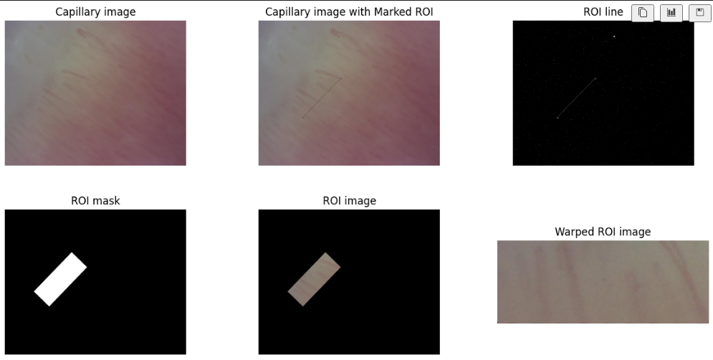
Pre-Processing:

Slide 6
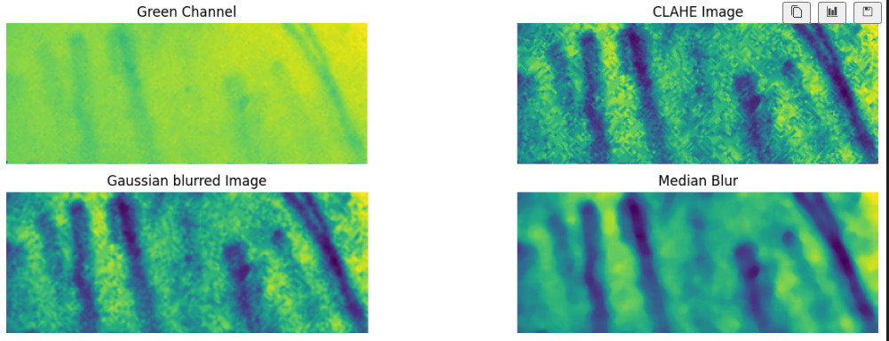
Pre-Processing:

Slide 7
Segmentation Methods
Adaptive Gausian thresholding (15, 2) calculates the threshold value based on the local characteristics of the image, accommodating variations in lighting and contrast.
T(x, y) = μ(x, y) - k * σ(x, y)
B(x, y) = neighborhood block around pixel (x, y)
μ(x, y) = local Gaussian-weighted average of B(x, y).
σ(x, y) = local standard deviation within block B(x, y).
k = constant value or offset.
adaptive Gaussian thresholding considers both the mean and standard deviation of the local neighborhood, while adaptive mean thresholding only considers the local mean. Adaptive Gaussian thresholding can be more effective in handling images with varying levels of noise and illumination, as it takes into account the variability in the neighborhood

Slide 8
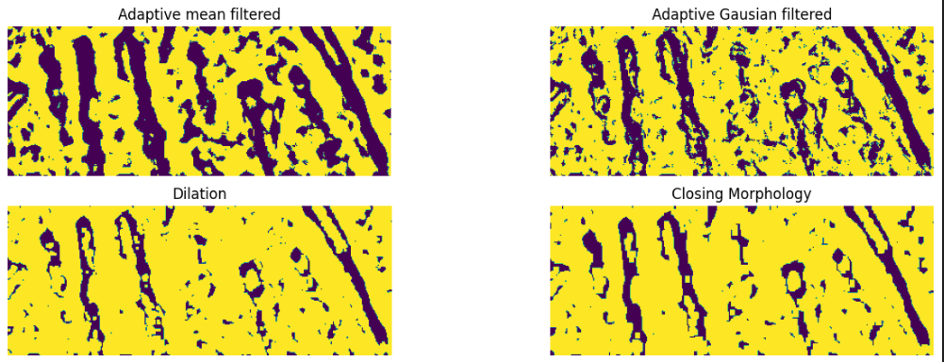
Segmentation Methods

Slide 9
Features
Capillary feature extraction, performed after connected component analysis on capillary images, aims to extract relevant characteristics from the identified capillary segments.
These characteristics can include metrics such as
length, width, tortuosity, branching patterns, and density.

Slide 10
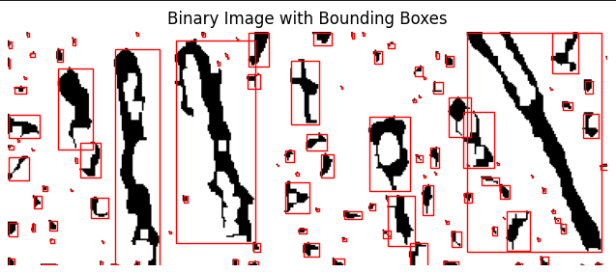

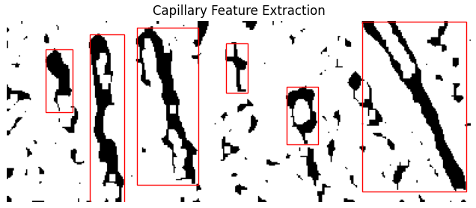
Features
Number of True Capillaries Present is: 6

Slide 11
Conclusion
Our capillary detection work demonstrates the effectiveness of the proposed methodology combining preprocessing, adaptive Gaussian thresholding, and feature extraction techniques.
The preprocessing stage enhances image quality, reducing noise and artifacts. The adaptive Gaussian thresholding accurately segments capillary structures by adapting to local image characteristics.
Finally, the feature extraction step captures relevant capillary characteristics, enabling quantitative analysis and aiding in the diagnosis of microvascular disorders.
Overall, our approach offers a robust framework for automated capillary detection in low-quality images, contributing to the advancement of capillaroscopic analysis in medical research and clinical practice.

Slide 12
THANK YOU

